Slide 1


2023 Pitt Business Analytics Case Competition
Crafted by: Will Drewes, Zac Harris, Ian Lindstrom, Logan Thompson

Slide 2



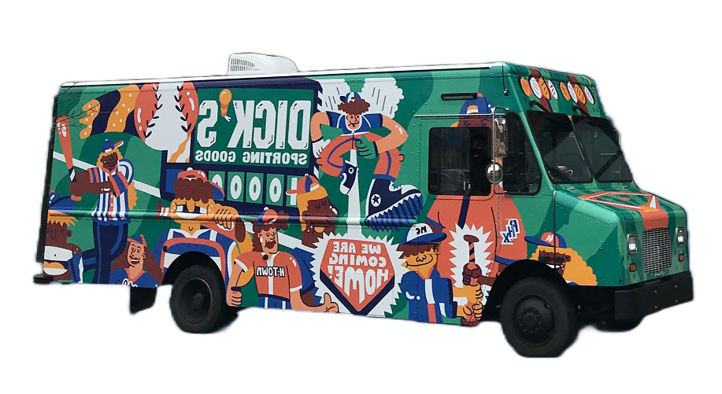
En Route: Estimated Arrival 7 Minutes
Dicks Sporting Goods Background
Shift in Office Footwear
Future of Footwear Sales
DSG’s Success Takeaways
DSG’s Footwear Department Growth
eCommerce in DSG
Notes:
Use better transitions: First..., next..., that will lead into..., additionally..., furthermore..., finally...

Slide 3
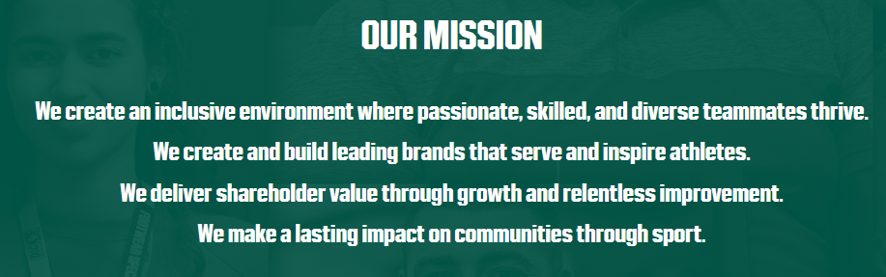
Background of Dick’s Sporting Goods
Founded in 1948 by Dick Stack and headquartered in Pittsburgh
The Dick’s family includes Golf Galaxy, Field & Stream, Public Lands, and Going Going Gone!
Built on beliefs that sports make people better and by doing what is right is what makes Dicks successful
Notes:
Obviously, it has turned into one of if not the biggest sports wear store today.
For Dicks background, it's built on beliefs...
As you can see to the right, Dicks mission statement creates an environment of diversity and passion. Dicks does a great job of giving back to the community with the creation of the Dicks Sporting Goods Foundation
One of the leading brands that Dicks has helped revolutionized is the footwear department which Zac will go into more detail about

Slide 4
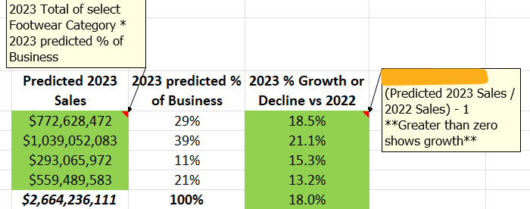
High-End Footwear Assortments are Expected to Showcase Continued Growth
Comfortability and convenience
Pop culture influences
Per capita income
Workplace acceptance
Notes:
Looking at how we learned that the overall sales would see growth was first found through finding the predicted 2023 sales
- saw that the 2022 sales for each category was found through multiplying the total by the % of business
- found growth by dividing the 2023 predicted sales by 2022 sales and subtracting 100%
Why is there a predicted growth?
First, consumers want comfort and convenience in their shoes.
Consumers are being regularly influenced by social media, athletes, and other elements of pop culture (T.V., movies, music, etc.)
Increasing demand for convenient and comfortable footwear among all generations (athleisure)
It has become more acceptable to wear sneakers in professional or formal settings
Increase in per capita disposable income
Get down to 1:15-1:30, focus on Excel more

Slide 5
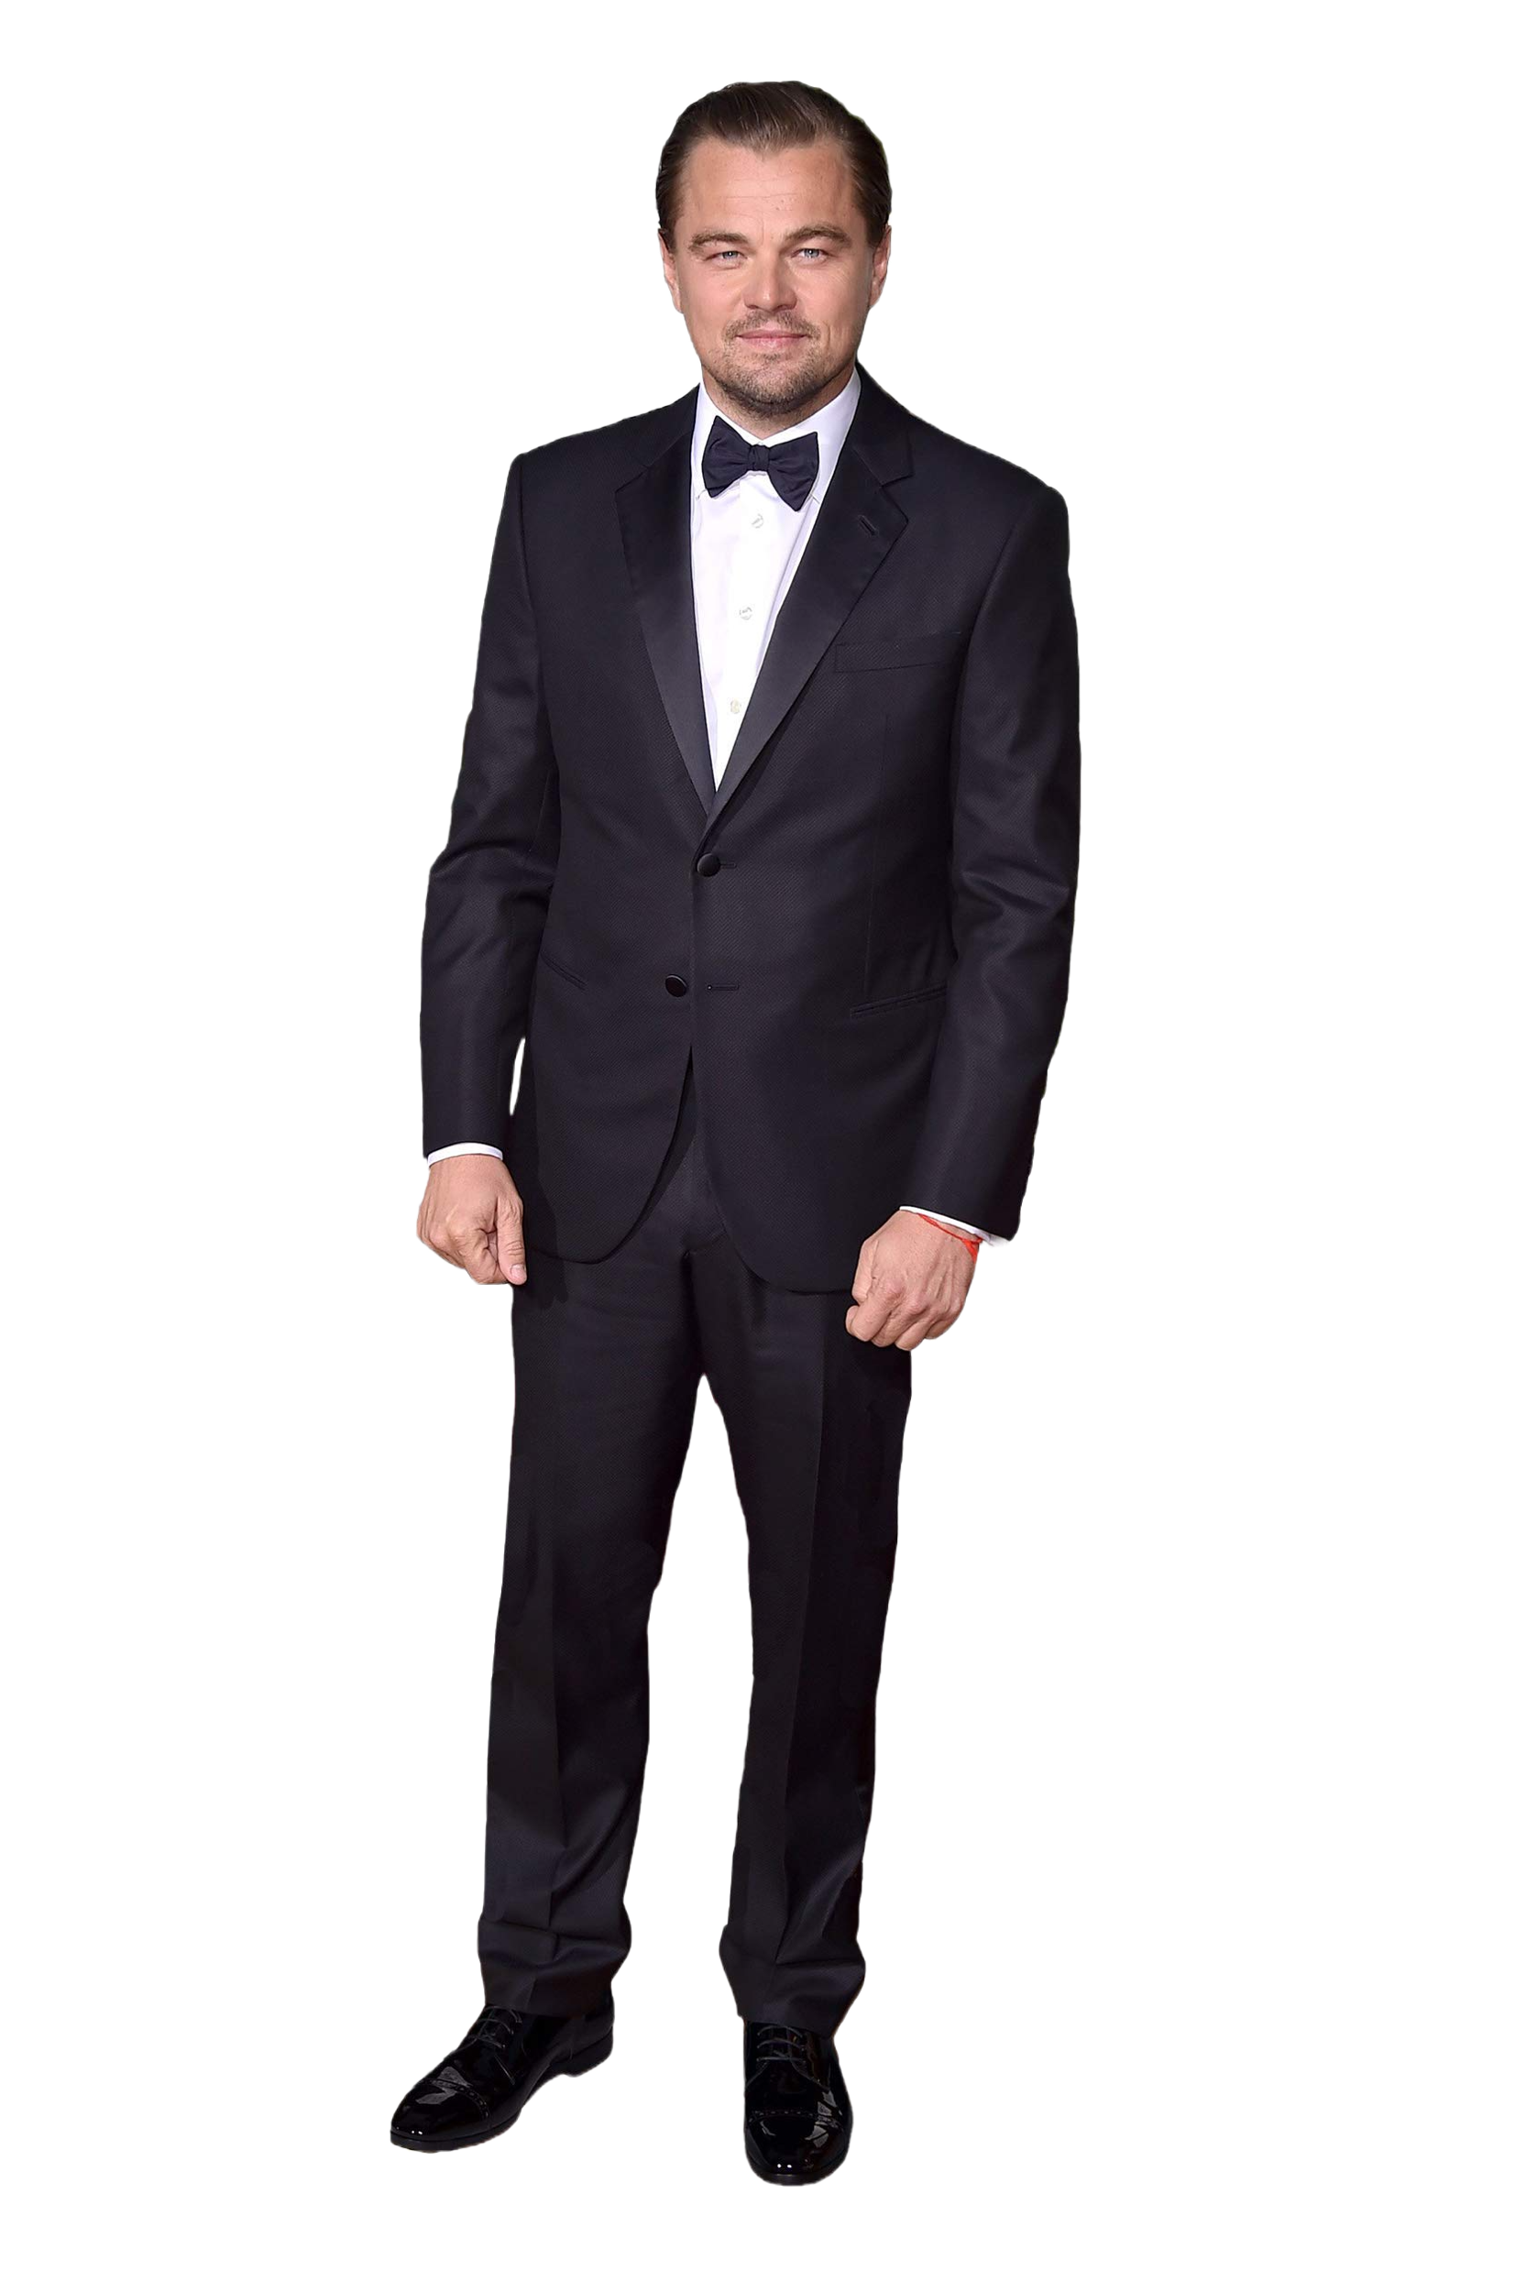
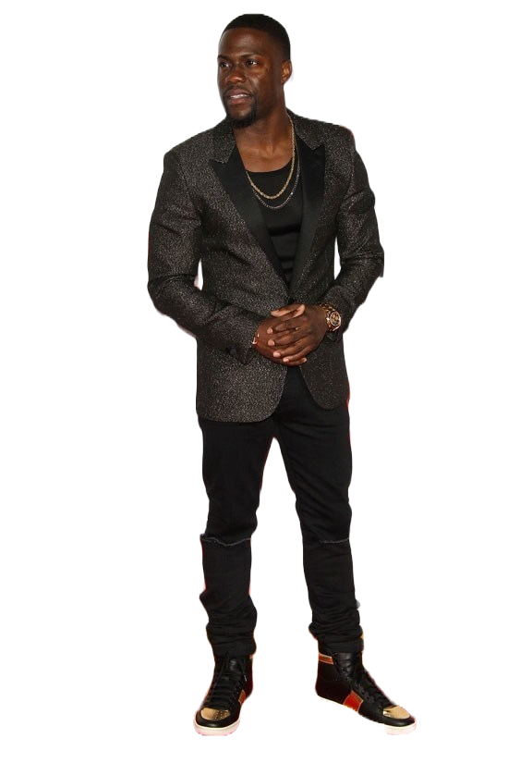
Adaptation of Footwear in the Office
Kevin Hart
The employee who has now evolved into the “new era” of casual footwear in the office
Leonardo DiCaprio
The ”traditionally” dressed employee until the shift of footwear trends in the office
Old Style Footwear
Modern Day Footwear
Notes:
What acceptance of footwear used to be is more formal and traditionally dressed footwear
Now, there has been a shift where people are starting to wear more athletic and casual footwear in the workplace
Dicks Sporting Goods is known for its athletic and casual footwear and with this trend of accepting casual footwear in the workplace, footwear sales at Dicks have increased
76% of the population believes that sneakers are acceptable in various settings (i.e. at work, formal occasions)

Slide 6
DSG’s Rise Toward Today’s eCommerce Success
2019 (Pre-COVID)
2021 (Post-COVID)
80% of eCommerce sales are generated within brick-and-mortar stores.
70% of eCommerce sales are filled by stores.
eCommerce sales increased 3.7% from 2018, and eCommerce penetration grew to 16% of total net sales
eCommerce sales increased 81% from 2019, and eCommerce penetration grew to 21% of total net sales
Insourced eCommerce platform that allows for innovation and enhancements
Increase availability, accessibility, increase athlete engagement, and add curbside pickup
Notes:
Improve functionality and performance of eCommerce sites and mobile app
Build faster/more convenient checkout process with new payment options, greater visibility, and accuracy of delivery dates, improved page responsiveness, enhancing integration of Scorecard loyalty program, net content development, and localized website experiences.
Before COVID: Buy online pick up in store already growing as it grew twice the rate of the online business in 2019
DSG has invested lots into its in-house eCommerce systems including its website, app, and distribution leading it to being one of the leaders in the retail industry.

Slide 7
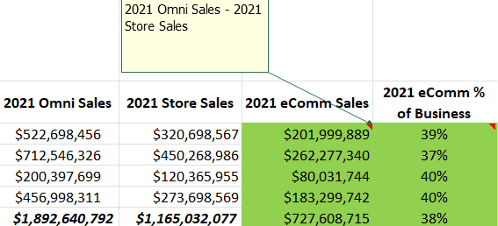

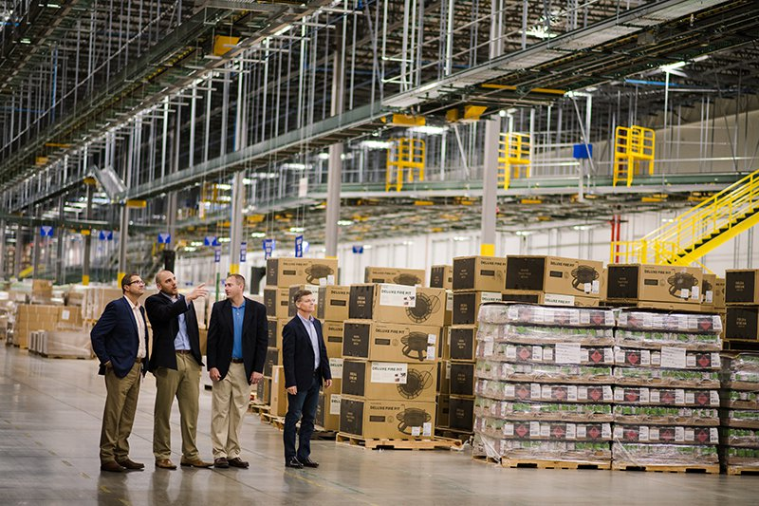
eCommerce in 2021

Slide 8
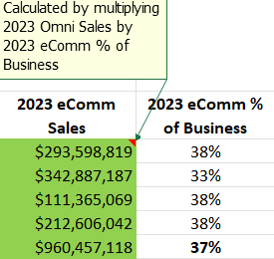
Footwear eCommerce is Expected to Continue Strong Growth through 2023 and Beyond
User Accessibility
Comfortability
Product Availability
Advertisements
Athlete Engagement
Notes:
Users are now connected to the internet and the digital age more than ever before making eCommerce the easiest and most accessible way for customers to find the products they are looking for.
The social change from COVID led consumers to become more comfortable with eCommerce as a whole and especially within the Footwear world. COVID forced people to learn about the benefits and ease that come with eCommerce as they are now on their phone more than ever with easy access from apps and websites to any retailer they need. Additionally, COVID made people get into active exercise and running, thus creating a higher generated overall purchasing of footwear. This combination of more shoes purchased and the purchase type being through eCommerce made people comfortable to know what brand and size they want. This ties back to the user accessibility as customers can now simply shop online with the knowledge of all they need to look at for the future is look rather than fit.
Product availability refers to that stores don’t have to worry about being short on inventory. Now offering a plethora of different methods via eCommerce, customers can be ensured that their Dicks Sporting Goods experience offers them the product and fit that they desire no matter what.
With the increased use of technology and purchasing online, customers are now more frequently shown to advertisements, thus increasing the engagement and conversion rates. Thanks to digital marketing, companies know how to better target their consumers based on past buying decisions. Companies have the opportunity to make analytical data gathering through such eCommerce methods that are used for the advertisement and overall online ordering experience.
The ability to sell uniquely online lets athletes engage at new levels. Whether it’s through content creation, user-focused advertisement, or making athlete-exclusive footwear brands, eCommerce lets athletes engage and grow popularity to new heights with DSG alike.

Slide 9
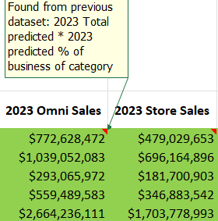

Remaining Footwear Projections
Footwear is a flourishing, growing asset
New partnership with Nike extends growth
Men’s footwear expected to grow by over 20%
Notes:
Net sales were $12.29 billion in fiscal 2021, a 28.3% increase from net sales of $9.58 billion in fiscal 2020. The remaining $261.6 million increase in net sales was primarily attributable to new and relocated stores. The increase in consolidated same store sales was driven by balanced growth across hardlines, apparel and footwear
https://www.retaildive.com/news/dicks-touts-incredibly-strategic-relationship-with-nike-as-it-posts-anot/620021/

Slide 10
DSG’s Success Takeaways
Accessibility
Adaptiveness
Growth
Availability
Social Influence

